Slide 1
Unsupervised Learning

Slide 2
Supervised vs Unsupervised Learning
Supervised Learning
Data: (x, y)
x is data, y is label
Goal: Learn a function to map x -> y
Examples: Classification, regression, object detection, semantic segmentation, image captioning, etc.
Lecture 13 -
2

Slide 3
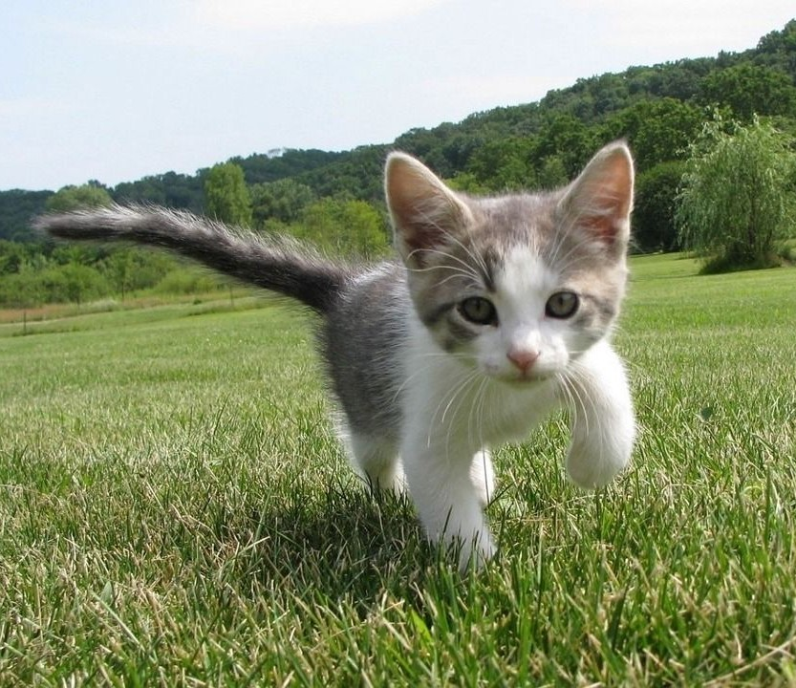
Supervised vs Unsupervised Learning
Supervised Learning
Data: (x, y)
x is data, y is label
Cat
Goal: Learn a function to map x -> y
Examples: Classification, regression, object detection, semantic segmentation, image captioning, etc.
Classification
This image is CC0 public domain
Lecture 13 -
3

Slide 4
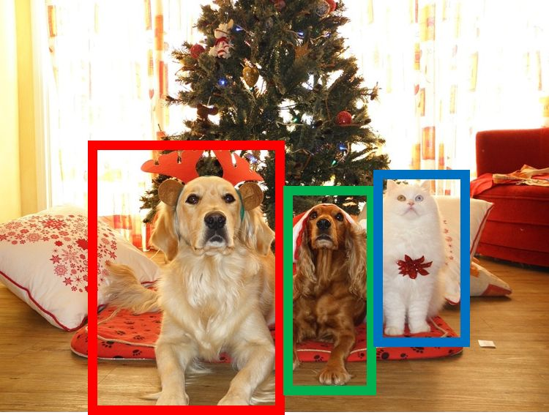
Supervised vs Unsupervised Learning
Supervised Learning
Data: (x, y)
x is data, y is label
Goal: Learn a function to map x -> y
Examples: Classification, regression, object detection, semantic segmentation, image captioning, etc.
DOG, DOG, CAT
Object Detection
This image is CC0 public domain
Lecture 13 -
4

Slide 5
Supervised vs Unsupervised Learning
Supervised Learning
Data: (x, y)
x is data, y is label
Goal: Learn a function to map x -> y
Examples: Classification, regression, object detection, semantic segmentation, image captioning, etc.
GRASS, CAT, TREE, SKY
Semantic Segmentation
5

Slide 6

Supervised vs Unsupervised Learning
Supervised Learning
Data: (x, y)
x is data, y is label
Goal: Learn a function to map x -> y
Examples: Classification, regression, object detection, semantic segmentation, image captioning, etc.
A cat sitting on a suitcase on the floor
Image captioning
Caption generated using neuraltalk2 Image is CC0 Public domain.
Lecture 13 -
6

Slide 7
Supervised vs Unsupervised Learning
Unsupervised Learning
Data: x
Just data, no labels!
Goal: Learn some underlying hidden structure of the data
Examples: Clustering, dimensionality reduction, feature learning, density estimation, etc.
Lecture 13 -
7
Notes:
Grouping / Axis of Variation / Underlying density estimation

Slide 8
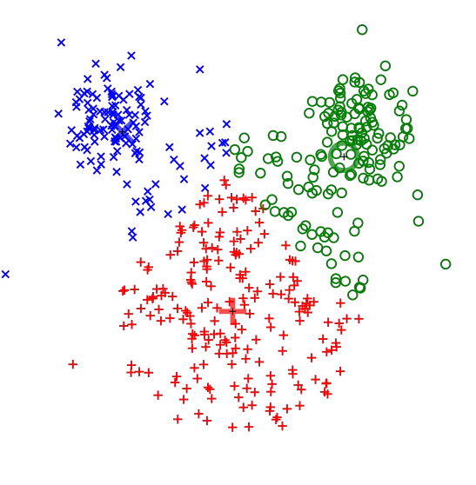
Supervised vs Unsupervised Learning
Unsupervised Learning
Data: x
Just data, no labels!
Goal: Learn some underlying hidden structure of the data
Examples: Clustering, dimensionality reduction, feature learning, density estimation, etc.
K-means clustering
This image is CC0 public domain
Lecture 13 -
10

Slide 9
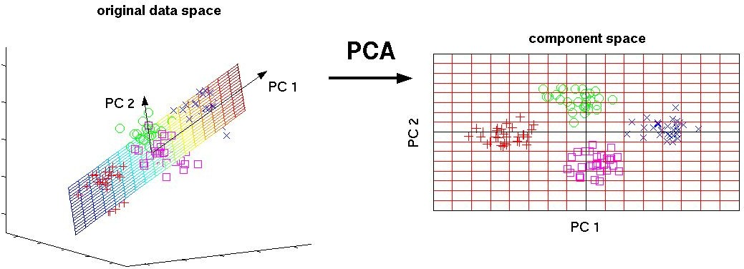
Supervised vs Unsupervised Learning
Unsupervised Learning
Data: x
Just data, no labels!
Goal: Learn some underlying hidden structure of the data
3-d 2-d
Principal Component Analysis (Dimensionality reduction)
Examples: Clustering, dimensionality reduction, feature learning, density estimation, etc.
This image from Matthias Scholz is CC0 public domain

Slide 10
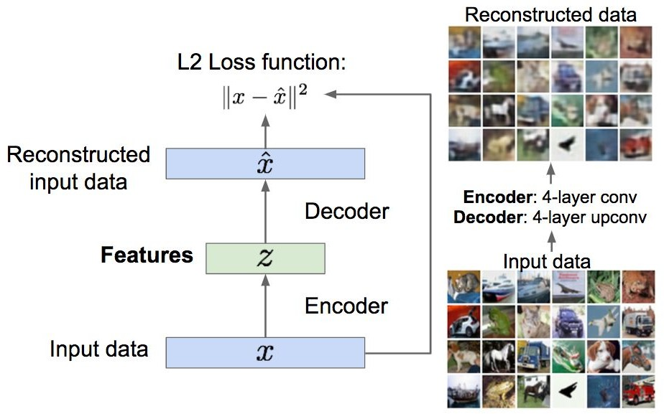
Supervised vs Unsupervised Learning
Unsupervised Learning
Data: x
Just data, no labels!
Goal: Learn some underlying hidden structure of the data
Examples: Clustering, dimensionality reduction, feature learning, density estimation, etc.
Autoencoders (Feature learning)

Slide 11
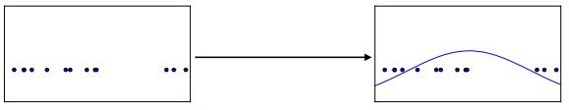
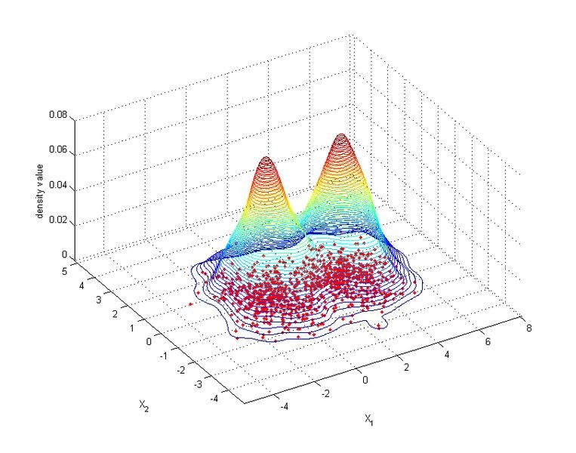
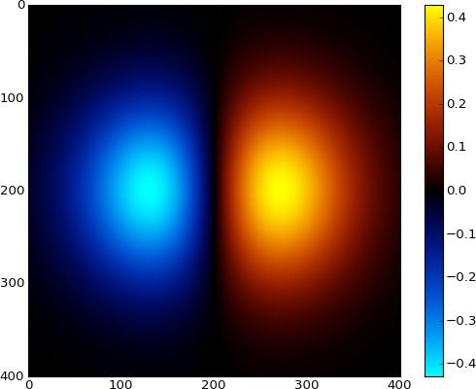
Supervised vs Unsupervised Learning
Unsupervised Learning
Data: x
Just data, no labels!
Figure copyright Ian Goodfellow, 2016. Reproduced with permission.
1-d density estimation
Goal: Learn some underlying hidden structure of the data
Examples: Clustering, dimensionality reduction, feature learning, density estimation, etc.
2-d density estimation
2-d density images left and right are CC0 public domain

Slide 12
Supervised vs Unsupervised Learning
Supervised Learning
Data: (x,y)
x is data, y is label
Goal: Learn a function to
map x -> y
Examples: Classification, regression, object detection, semantic segmentation, image captioning, etc.
Unsupervised Learning
Data: x
Just data, no labels!
Goal: Learn some underlying hidden structure of the data
Examples: Clustering, dimensionality reduction, feature learning, density estimation, etc.

Slide 13
Supervised vs Unsupervised Learning
Supervised Learning
Data: (x,y)
x is data, y is label
Goal: Learn a function to
map x -> y
Examples: Classification, regression, object detection, semantic segmentation, image captioning, etc.
Unsupervised Learning
Training data is cheap
Data: x
Just data, no labels!
Holy grail: Solve unsupervised learning
=> understand structure of visual world
Goal: Learn some underlying hidden structure of the data
Examples: Clustering, dimensionality reduction, feature learning, density estimation, etc.
Lecture 13 -

Slide 14
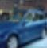
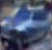
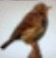
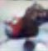
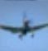
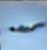
Given training data, generate new samples from same distribution
Generative Models
Training data ~ p_{data}(x) Generated samples ~ p_{model}(x)
Want to learn p_{model}(x) similar to p_{data}(x)
Lecture 13 -

Slide 15
Given training data, generate new samples from same distribution
Generative Models
Training data ~ p_{data}(x) Generated samples ~ p_{model}(x)
Want to learn p_{model}(x) similar to p_{data}(x)
Addresses density estimation, a core problem in unsupervised learning
Several flavors:
Explicit density estimation: explicitly define and solve for p_{model}(x)
Implicit density estimation: learn model that can sample from p_{model}(x) w/o explicitly defining it
Lecture 13 -

Slide 16
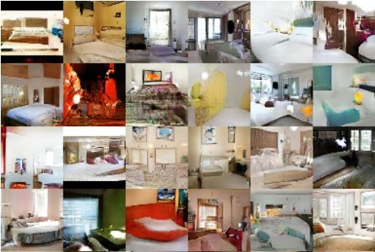
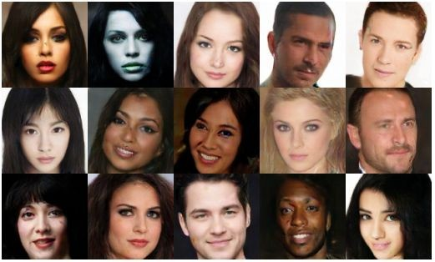
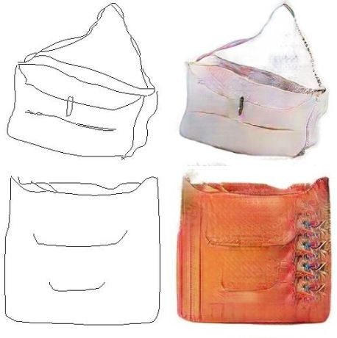
Why Generative Models?
- Realistic samples for artwork, super-resolution, colorization, etc.
Generative models of time-series data can be used for simulation and planning (reinforcement learning applications!)
Training generative models can also enable inference of latent representations that can be useful as general features
FIgures from L-R are copyright: (1) Alec Radford et al. 2016; (2) David Berthelot et al. 2017; Phillip Isola et al. 2017. Reproduced with authors permission.

Slide 17
Taxonomy of Generative Models
Direct
GAN
Generative models
Explicit density
Implicit density
Markov Chain
Tractable density
Approximate density
Fully Visible Belief Nets
GSN
NADE
MADE
PixelRNN/CNN
Variational
Markov Chain
Variational Autoencoder Boltzmann Machine
Figure copyright and adapted from Ian Goodfellow, Tutorial on Generative Adversarial Networks, 2017.
Change of variables models (nonlinear ICA)
Lecture 13 -

Slide 18
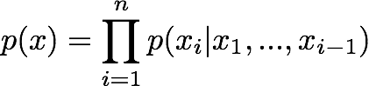
Fully visible belief network
Explicit density model
Use chain rule to decompose likelihood of an image x into product of 1-d distributions:
Will need to define ordering of “previous pixels”
Likelihood of image x
Probability of i’th pixel value given all previous pixels
Complex distribution over pixel values => Express using a neural network!
Then maximize likelihood of training data
Lecture 13 -

Slide 19
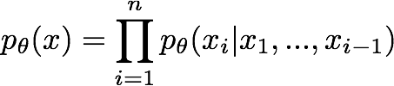
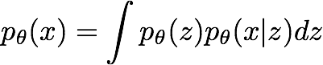
Tractable vs Intractable Density Function
PixelCNNs define tractable density function, optimize likelihood of training data:
VAEs define intractable density function with latent z:
Cannot optimize directly, derive and optimize lower bound on likelihood instead
Lecture 13 -

Slide 20
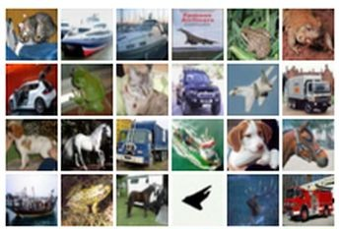
Some background first: Autoencoders
Unsupervised approach for learning a lower-dimensional feature representation from unlabeled training data
Features
Encoder
Input data
Lecture 13 -

Slide 21
Some background first: Autoencoders
Unsupervised approach for learning a lower-dimensional feature representation from unlabeled training data
Originally: Linear + nonlinearity (sigmoid)
Later: Deep, fully-connected
Later: ReLU CNN
Features
Encoder
Input data
Lecture 13 -

Slide 22
Some background first: Autoencoders
Unsupervised approach for learning a lower-dimensional feature representation from unlabeled training data
z usually smaller than x
(dimensionality reduction)
Originally: Linear + nonlinearity (sigmoid)
Later: Deep, fully-connected
Later: ReLU CNN
Q: Why dimensionality reduction?
Features
Encoder
Input data
Lecture 13 -

Slide 23
Some background first: Autoencoders
Unsupervised approach for learning a lower-dimensional feature representation from unlabeled training data
z usually smaller than x
(dimensionality reduction)
Originally: Linear + nonlinearity (sigmoid)
Later: Deep, fully-connected
Later: ReLU CNN
Q: Why dimensionality reduction?
A: Want features to capture meaningful factors of variation in data
Features
Encoder
Input data
Lecture 13 -

Slide 24
Some background first: Autoencoders
How to learn this feature representation?
Features
Encoder
Input data
Lecture 13 -

Slide 25
Some background first: Autoencoders
How to learn this feature representation?
Train such that features can be used to reconstruct original data “Autoencoding” - encoding itself
Reconstructured data
Decoder
Features
Encoder
Input data
Lecture 13 -

Slide 26
Some background first: Autoencoders
How to learn this feature representation?
Train such that features can be used to reconstruct original data “Autoencoding” - encoding itself
nonlinearity (sigmoid)
Later: Deep, fully-connected
Later: ReLU CNN (upconv)
Reconstructured data
Decoder
Features
Encoder
Input data
Lecture 13 -
Lecture 13 -

Slide 27
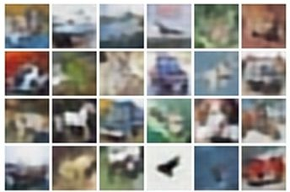
Some background first: Autoencoders
Reconstructed data
How to learn this feature representation?
Train such that features can be used to reconstruct original data “Autoencoding” - encoding itself
Reconstructured data
Encoder: 4-layer conv
Decoder: 4-layer upconv
Decoder
Features
Input data
Encoder
Input data
Lecture 13 -
Lecture 13 -

Slide 28
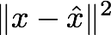
Some background first: Autoencoders
L2 Loss function:
Reconstructed data
Train such that features
can be used to reconstruct original data
Reconstructured data
Encoder: 4-layer conv
Decoder: 4-layer upconv
Decoder
Features
Input data
Encoder
Input data

Slide 29
Some background first: Autoencoders
Reconstructured data
Decoder
Features
After training,
throw away decoder
Encoder
Input data
Lecture 13 -

Slide 30
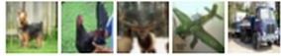
Some background first: Autoencoders
Encoder can be used to initialize a supervised model
Loss function (Softmax, etc)
bird
plane
dog
deer
truck
Predicted Label
Fine-tune encoder jointly with classifier
Train for final task (sometimes with small data)
Classifier
Features
Encoder
Input data
Lecture 13 -

Slide 31
Some background first: Autoencoders
Autoencoders can reconstruct data, and can learn features to initialize a supervised model
Features capture factors of variation in training data. Can we generate new images from an autoencoder?
Reconstructured data
Decoder
Features
Encoder
Input data
Lecture 13 -

Slide 32
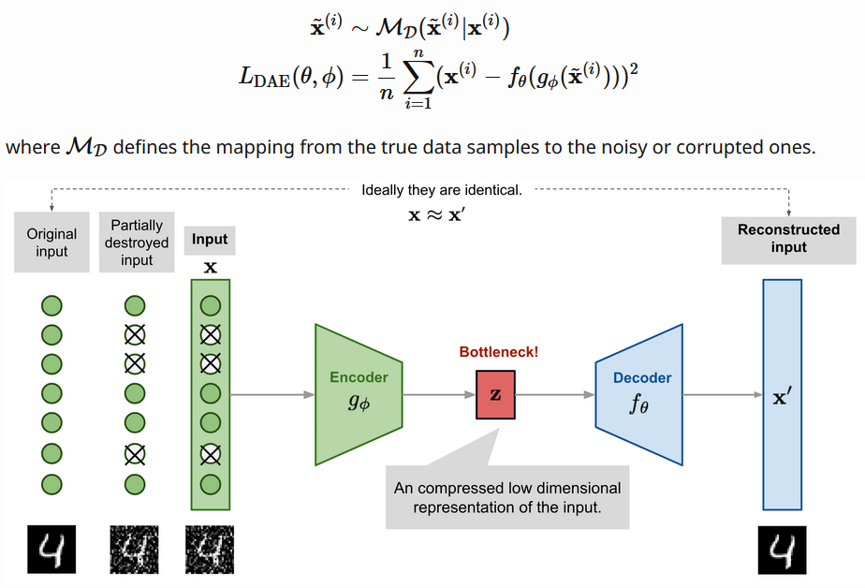
Denoised Autoencoders

Slide 33
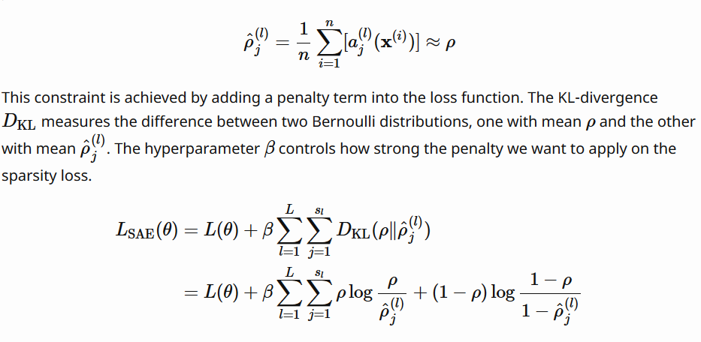
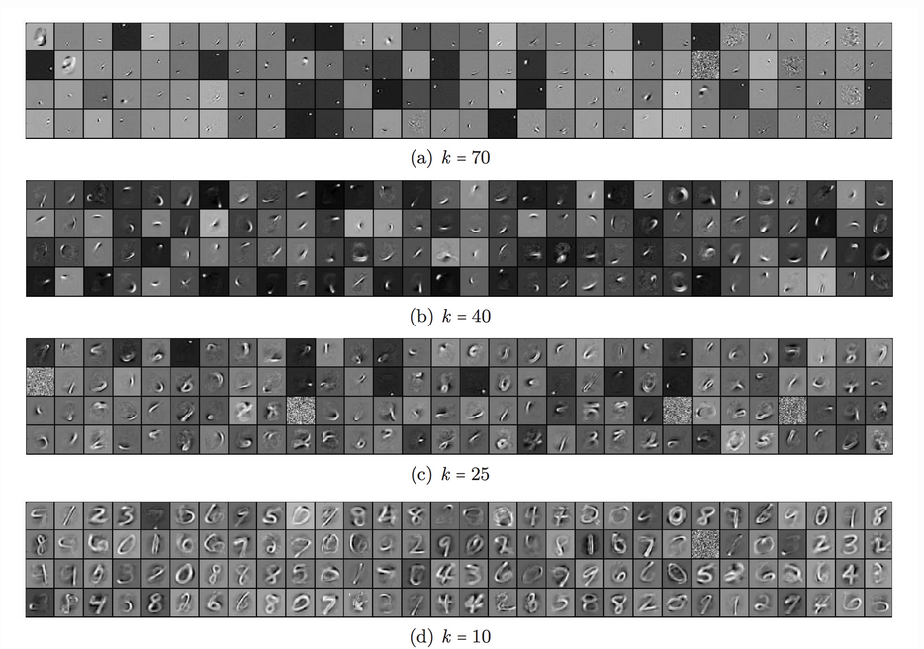
Sparse Autoencoders – K- Sparse Autoencoders
https://www.doc.ic.ac.uk/~js4416/163/website/autoencoders/sparse.html

Slide 34
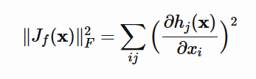
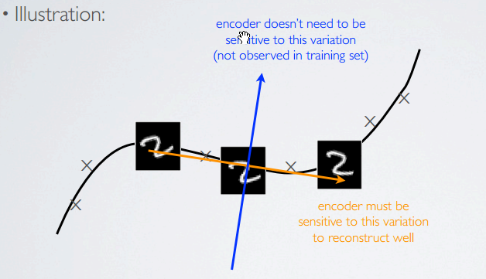
Contractive Autoencoders
Euclidean Loss
+
Additive Term to the Reconstruction Error

Slide 35
Variational Autoencoders
Probabilistic spin on autoencoders - will let us sample from the model to generate data!
Lecture 13 -

Slide 36
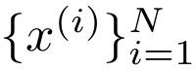
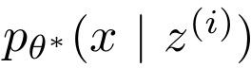
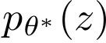
Variational Autoencoders
Probabilistic spin on autoencoders - will let us sample from the model to generate data!
Assume training data is generated from underlying unobserved (latent) representation z
Sample from true conditional
Sample from true prior
Kingma and Welling, “Auto-Encoding Variational Bayes”, ICLR 2014
Lecture 13 -

Slide 37
Variational Autoencoders
Probabilistic spin on autoencoders - will let us sample from the model to generate data!
Assume training data is generated from underlying unobserved (latent) representation z
Intuition (remember from autoencoders!): x is an image, z is latent factors used to generate x: attributes, orientation, etc.
Sample from true conditional
Sample from true prior
Kingma and Welling, “Auto-Encoding Variational Bayes”, ICLR 2014
Lecture 13 -

Slide 38
Variational Autoencoders
We want to estimate the true parameters of this generative model.
Sample from true conditional
Sample from true prior
Kingma and Welling, “Auto-Encoding Variational Bayes”, ICLR 2014
Lecture 13 -

Slide 39
Variational Autoencoders
We want to estimate the true parameters of this generative model.
Sample from true conditional
How should we represent this model?
Sample from true prior
Kingma and Welling, “Auto-Encoding Variational Bayes”, ICLR 2014
Lecture 13 -

Slide 40
Variational Autoencoders
We want to estimate the true parameters of this generative model.
Sample from true conditional
How should we represent this model?
Choose prior p(z) to be simple, e.g. Gaussian. Reasonable for latent attributes,
e.g. pose, how much smile.
Sample from true prior
Kingma and Welling, “Auto-Encoding Variational Bayes”, ICLR 2014
Lecture 13 -

Slide 41
Variational Autoencoders
We want to estimate the true parameters of this generative model.
Sample from true conditional
How should we represent this model?
Choose prior p(z) to be simple, e.g. Gaussian.
Conditional p(x|z) is complex (generates image) => represent with neural network
Decoder network
Sample from true prior
Kingma and Welling, “Auto-Encoding Variational Bayes”, ICLR 2014
Lecture 13 -

Slide 42
Variational Autoencoders
We want to estimate the true parameters of this generative model.
Sample from true conditional
How to train the model?
Decoder network
Sample from true prior
Kingma and Welling, “Auto-Encoding Variational Bayes”, ICLR 2014
Lecture 13 -

Slide 43
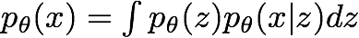
Variational Autoencoders
We want to estimate the true parameters of this generative model.
Sample from true conditional
How to train the model?
Learn model parameters to maximize likelihood of training data
Decoder network
Sample from true prior
Kingma and Welling, “Auto-Encoding Variational Bayes”, ICLR 2014
Lecture 13 -

Slide 44
Variational Autoencoders
We want to estimate the true parameters of this generative model.
Sample from true conditional
How to train the model?
Learn model parameters to maximize likelihood of training data
Decoder network
Sample from true prior
Now with latent z
Kingma and Welling, “Auto-Encoding Variational Bayes”, ICLR 2014
Lecture 13 -

Slide 45
Variational Autoencoders
We want to estimate the true parameters of this generative model.
Sample from true conditional
How to train the model?
Learn model parameters to maximize likelihood of training data
Decoder network
Sample from true prior
Q: What is the problem with this?
Kingma and Welling, “Auto-Encoding Variational Bayes”, ICLR 2014
Lecture 13 -

Slide 46
Variational Autoencoders
We want to estimate the true parameters of this generative model.
Sample from true conditional
How to train the model?
Learn model parameters to maximize likelihood of training data
Decoder network
Sample from true prior
Q: What is the problem with this? Intractable!
Kingma and Welling, “Auto-Encoding Variational Bayes”, ICLR 2014
Lecture 13 -

Slide 47
Variational Autoencoders: Intractability
Data likelihood:
Kingma and Welling, “Auto-Encoding Variational Bayes”, ICLR 2014
Lecture 13 -

Slide 48
Variational Autoencoders: Intractability
✔
Data likelihood:
Simple Gaussian prior
Kingma and Welling, “Auto-Encoding Variational Bayes”, ICLR 2014
Lecture 13 -

Slide 49
Variational Autoencoders: Intractability
✔ ✔
Data likelihood:
Decoder neural network
Kingma and Welling, “Auto-Encoding Variational Bayes”, ICLR 2014
Lecture 13 -

Slide 50
Variational Autoencoders: Intractability
✔ ✔
Data likelihood:
Intractable to compute p(x|z) for every z!
Kingma and Welling, “Auto-Encoding Variational Bayes”, ICLR 2014
Lecture 13 -

Slide 51
Variational Autoencoders: Intractability
✔ ✔
Data likelihood:
Posterior density also intractable:
Kingma and Welling, “Auto-Encoding Variational Bayes”, ICLR 2014
Lecture 13 -

Slide 52
Variational Autoencoders: Intractability
✔ ✔
Data likelihood:
Posterior density also intractable:
✔ ✔
Intractable data likelihood
Kingma and Welling, “Auto-Encoding Variational Bayes”, ICLR 2014
Lecture 13 -

Slide 53
Variational Autoencoders: Intractability
Data likelihood:
✔ ✔
✔ ✔
Posterior density also intractable:
Solution: In addition to decoder network modeling p_{θ}(x|z), define additional encoder network q_{ɸ}(z|x) that approximates p_{θ}(z|x)
Will see that this allows us to derive a lower bound on the data likelihood that is tractable, which we can optimize
Kingma and Welling, “Auto-Encoding Variational Bayes”, ICLR 2014
Lecture 13 -

Slide 54
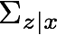
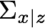
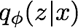
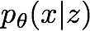
Mean and (diagonal) covariance of z | x Mean and (diagonal) covariance of x | z
Variational Autoencoders
Since we’re modeling probabilistic generation of data, encoder and decoder networks are probabilistic
Encoder network
Decoder network
(parameters ɸ )
(parameters θ)
Kingma and Welling, “Auto-Encoding Variational Bayes”, ICLR 2014

Slide 55
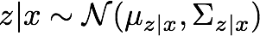
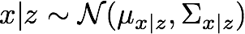
Variational Autoencoders
Since we’re modeling probabilistic generation of data, encoder and decoder networks are probabilistic
Sample z from
Sample x|z from
Encoder network
Decoder network
(parameters ɸ )
(parameters θ)
Kingma and Welling, “Auto-Encoding Variational Bayes”, ICLR 2014
Lecture 13 -

Slide 56
Variational Autoencoders
Since we’re modeling probabilistic generation of data, encoder and decoder networks are probabilistic
Sample z from
Sample x|z from
Encoder network
Decoder network
(parameters ɸ )
(parameters θ)
Encoder and decoder networks also called “recognition”/“inference” and “generation” networks
Kingma and Welling, “Auto-Encoding Variational Bayes”, ICLR 2014
Lecture 13 -

Slide 57
Now equipped with our encoder and decoder networks, let’s work out the (log) data likelihood:
Variational Autoencoders
Lecture 13 -

Slide 58
Now equipped with our encoder and decoder networks, let’s work out the (log) data likelihood:
Variational Autoencoders
Taking expectation wrt. z (using encoder network) will come in handy later
Lecture 13 -

Slide 59
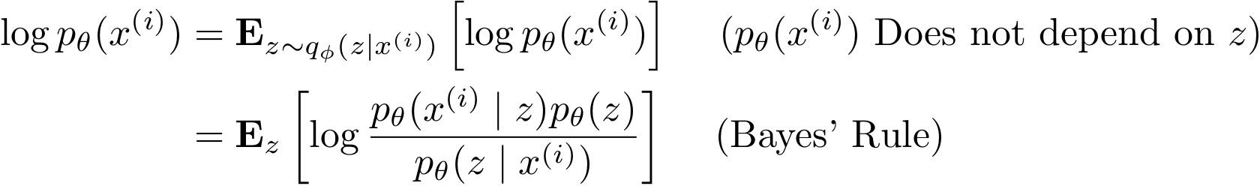
Now equipped with our encoder and decoder networks, let’s work out the (log) data likelihood:
Variational Autoencoders
Lecture 13 -

Slide 60
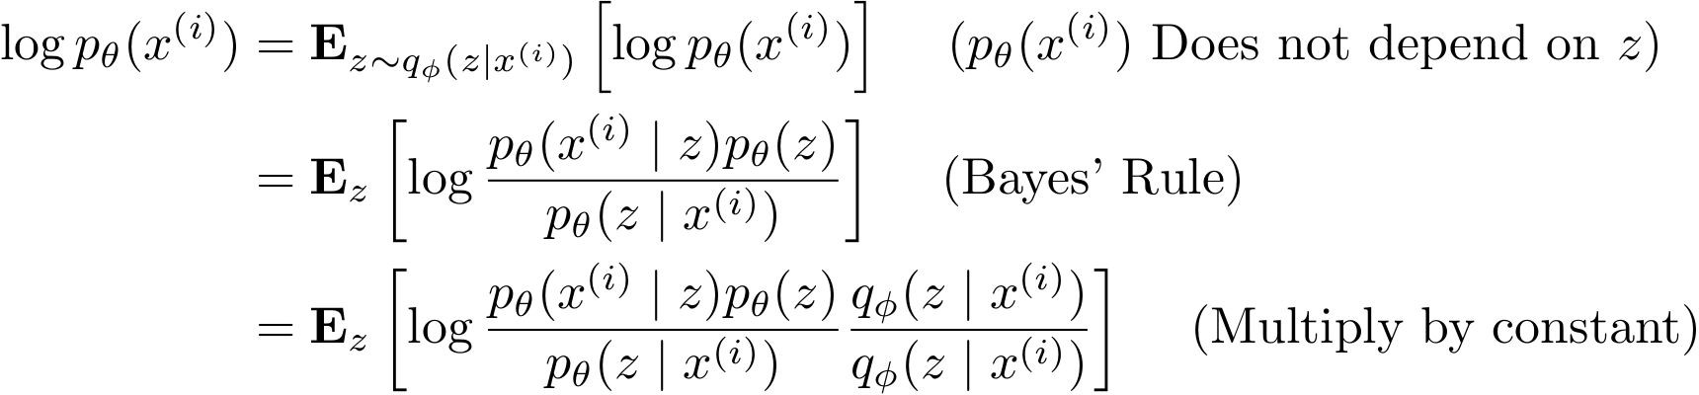
Now equipped with our encoder and decoder networks, let’s work out the (log) data likelihood:
Variational Autoencoders
Lecture 13 -

Slide 61
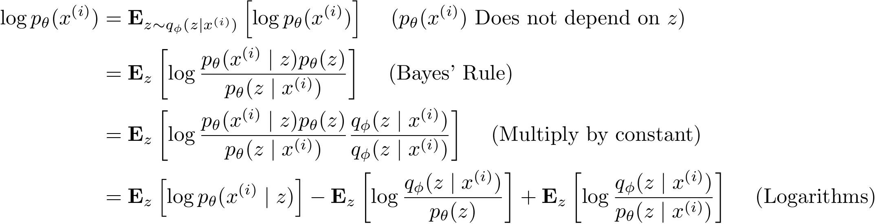
Now equipped with our encoder and decoder networks, let’s work out the (log) data likelihood:
Variational Autoencoders
Lecture 13 -

Slide 62
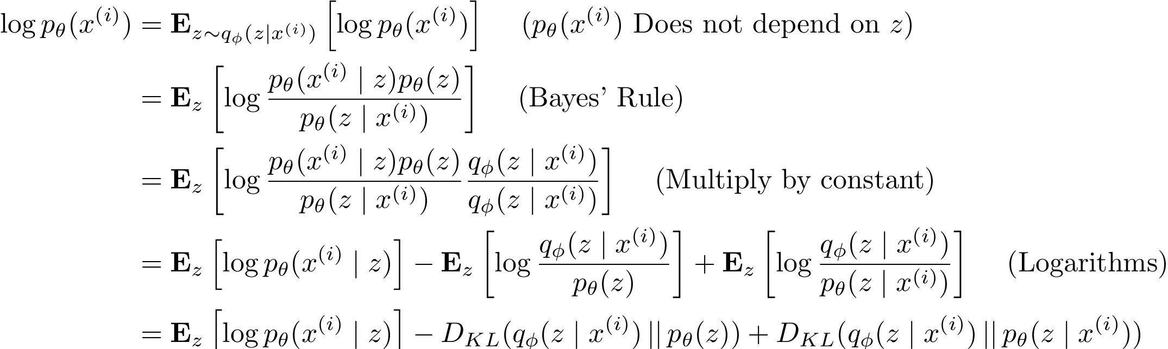
Now equipped with our encoder and decoder networks, let’s work out the (log) data likelihood:
Variational Autoencoders
Lecture 13 -

Slide 63
Now equipped with our encoder and decoder networks, let’s work out the (log) data likelihood:
Variational Autoencoders
The expectation wrt. z (using encoder network) let us write nice KL terms
Lecture 13 -

Slide 64
Now equipped with our encoder and decoder networks, let’s work out the (log) data likelihood:
Variational Autoencoders
Decoder network gives p_{θ}(x|z), can compute estimate of this term through sampling. (Sampling differentiable through reparam. trick, see paper.)
This KL term (between Gaussians for encoder and z prior) has nice closed-form solution!
p_{θ}(z|x) intractable (saw earlier), can’t compute this KL term :( But we know KL divergence always >= 0.
Lecture 13 -

Slide 65
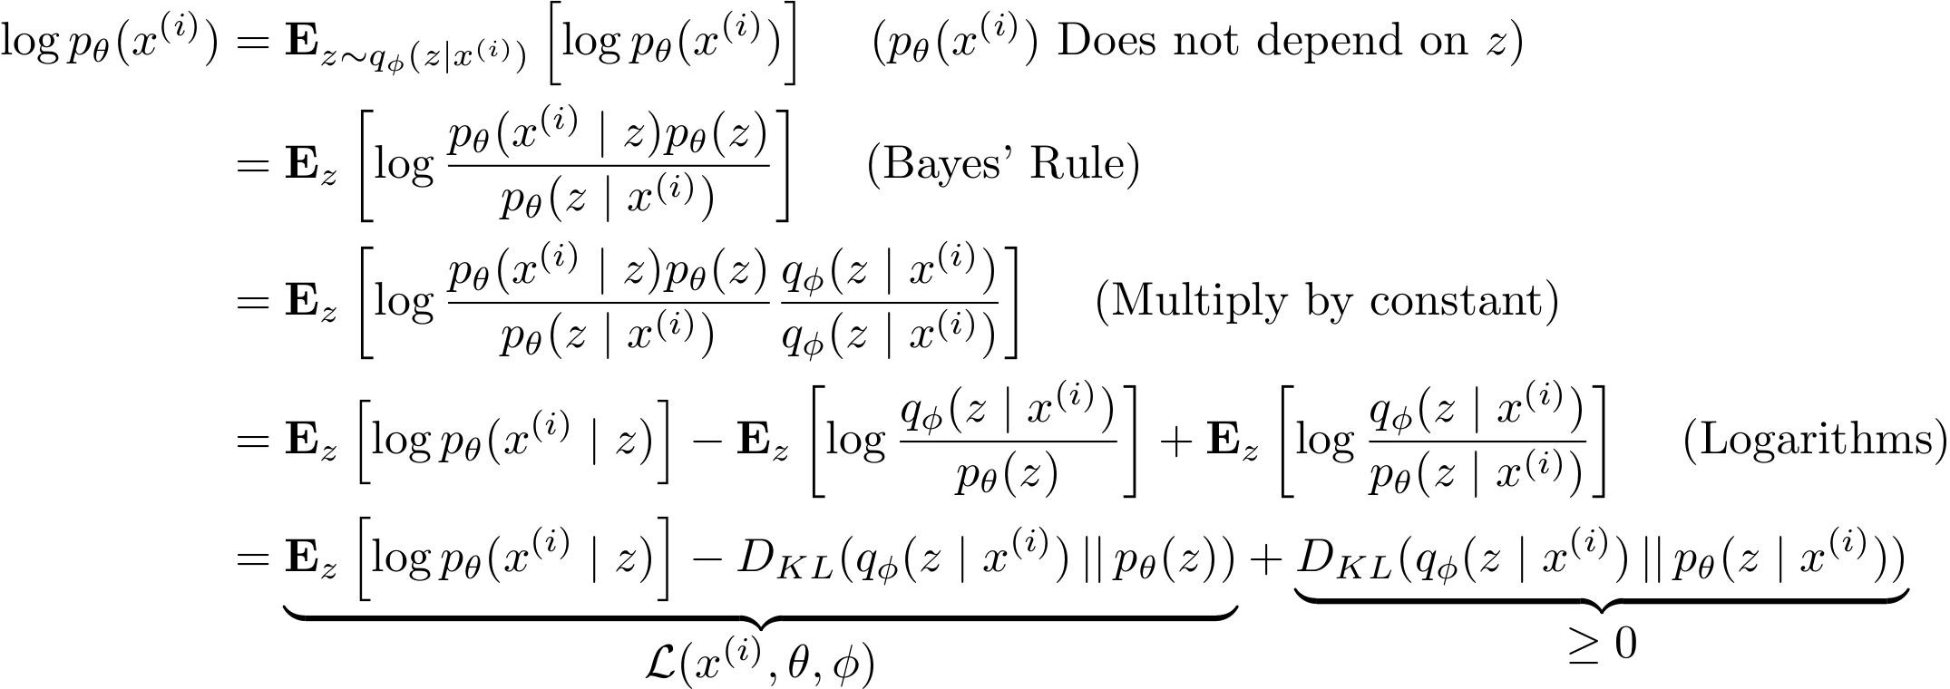
Now equipped with our encoder and decoder networks, let’s work out the (log) data likelihood:
Variational Autoencoders
Tractable lower bound which we can take gradient of and optimize! (p_{θ}(x|z) differentiable, KL term differentiable)
Lecture 13 -

Slide 66
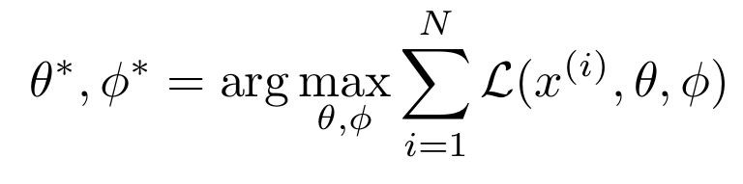
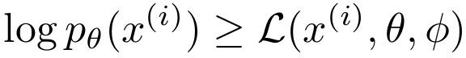
Now equipped with our encoder and decoder networks, let’s work out the (log) data likelihood:
Variational Autoencoders
Variational lower bound (“ELBO”)
Training: Maximize lower bound
Lecture 13 -

Slide 67
Now equipped with our encoder and decoder networks, let’s work out the (log) data likelihood:
Variational Autoencoders
Make approximate posterior distribution close to prior
Reconstruct the input data
Variational lower bound (“ELBO”)
Training: Maximize lower bound
Lecture 13 -

Slide 68
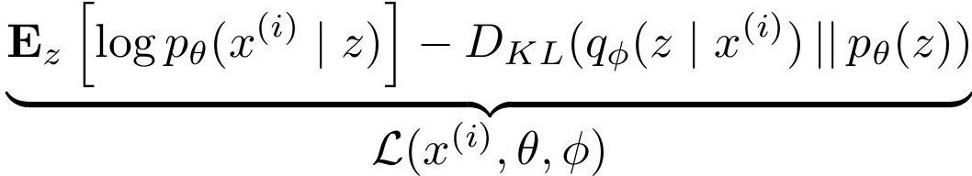
Variational Autoencoders
Putting it all together: maximizing the likelihood lower bound
Lecture 13 -

Slide 69
Variational Autoencoders
Putting it all together: maximizing the likelihood lower bound
Let’s look at computing the bound (forward pass) for a given minibatch of input data
Input Data
Lecture 13 -

Slide 70
Variational Autoencoders
Putting it all together: maximizing the likelihood lower bound
Encoder network
Input Data
Lecture 13 -

Slide 71
Variational Autoencoders
Putting it all together: maximizing the likelihood lower bound
Make approximate posterior distribution close to prior
Encoder network
Input Data
Lecture 13 -

Slide 72
Variational Autoencoders
Putting it all together: maximizing the likelihood lower bound
Sample z from
Make approximate posterior distribution close to prior
Encoder network
Input Data
Lecture 13 -

Slide 73
Variational Autoencoders
Putting it all together: maximizing the likelihood lower bound
Decoder network
Sample z from
Make approximate posterior distribution close to prior
Encoder network
Input Data
Lecture 13 -

Slide 74
Variational Autoencoders
Putting it all together: maximizing the likelihood lower bound
Maximize
likelihood of original input being reconstructed
Sample x|z from
Decoder network
Sample z from
Make approximate posterior distribution close to prior
Encoder network
Input Data
Lecture 13 -

Slide 75
Variational Autoencoders
Putting it all together: maximizing the likelihood lower bound
Maximize
likelihood of original input being reconstructed
Sample x|z from
Decoder network
Sample z from
Make approximate posterior distribution close to prior
Encoder network
For every minibatch of input data: compute this forward pass, and then backprop!
Input Data
Lecture 13 -

Slide 76
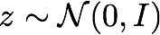
Variational Autoencoders: Generating Data!
Use decoder network. Now sample z from prior!
Sample x|z from
Decoder network
Sample z from
Kingma and Welling, “Auto-Encoding Variational Bayes”, ICLR 2014
Lecture 13 -

Slide 77
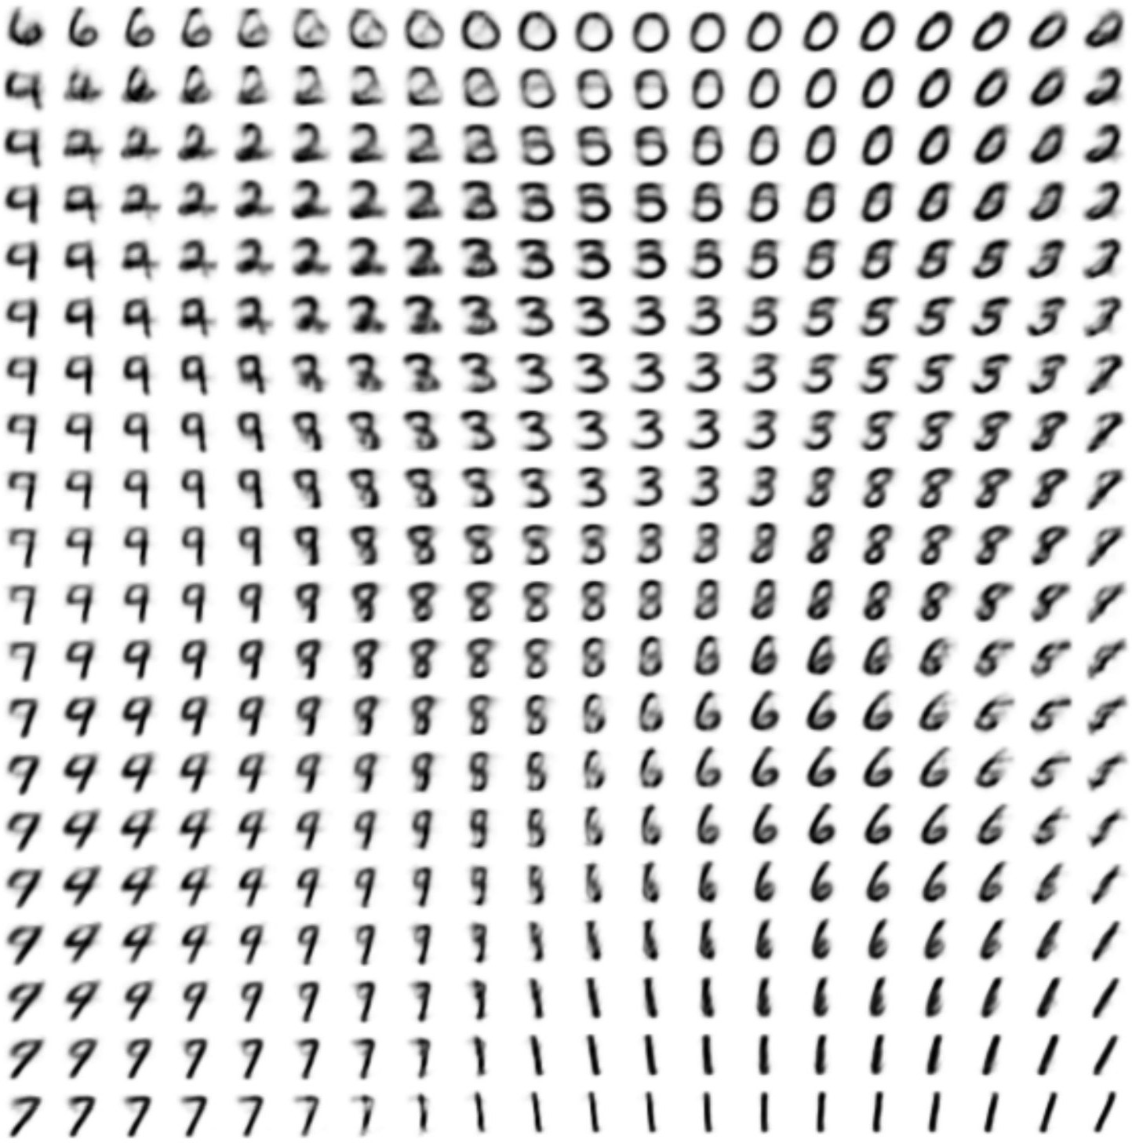
Variational Autoencoders: Generating Data!
Use decoder network. Now sample z from prior!
Sample x|z from
Decoder network
Sample z from
Kingma and Welling, “Auto-Encoding Variational Bayes”, ICLR 2014
Lecture 13 -

Slide 78
Variational Autoencoders: Generating Data!
Use decoder network. Now sample z from prior! Data manifold for 2-d z
Sample x|z from
Vary z₁
Decoder network
Sample z from
Kingma and Welling, “Auto-Encoding Variational Bayes”, ICLR 2014
Vary z₂
Lecture 13 -

Slide 79
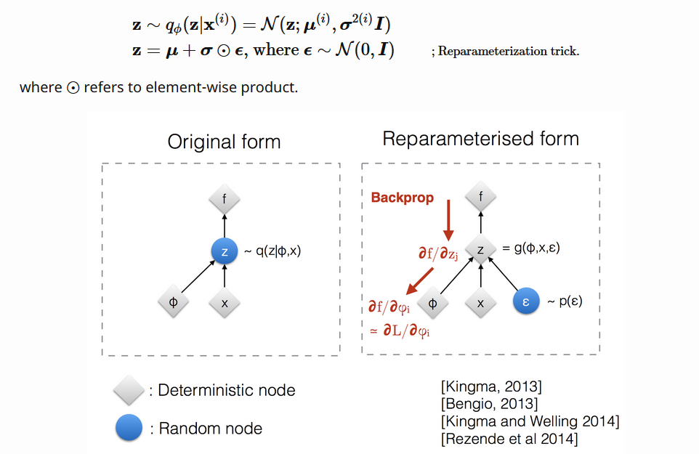
Variational Autoencoders: Reparametrization

Slide 80

Variational Autoencoders: Reparametrization

Slide 81

Variational Autoencoders: Beta VAE
https://lilianweng.github.io/lil-log/2018/08/12/from-autoencoder-to-beta-vae.html

Slide 82

Variational Autoencoders: Generating Data!
Diagonal prior on z
=> independent latent variables
Degree of smile
Different dimensions of z encode interpretable factors of variation
Vary z₁
Vary z₂
Lecture 13 -
Head pose
Kingma and Welling, “Auto-Encoding Variational Bayes”, ICLR 2014

Slide 83

Variational Autoencoders: Generating Data!
Diagonal prior on z
=> independent latent variables
Degree of smile
Different dimensions of z encode interpretable factors of variation
Vary z₁
Also good feature representation that can be computed using q_{ɸ}(z|x)!
Kingma and Welling, “Auto-Encoding Variational Bayes”, ICLR 2014
Vary z
Head pose
2
Lecture 13 -
95

Slide 84


Variational Autoencoders: Generating Data!
Labeled Faces in the Wild
32x32 CIFAR-10
Figures copyright (L) Dirk Kingma et al. 2016; (R) Anders Larsen et al. 2017. Reproduced with permission.
Lecture 13 -

Slide 85
Variational Autoencoders
Probabilistic spin to traditional autoencoders => allows generating data
Defines an intractable density => derive and optimize a (variational) lower bound
Pros:
Principled approach to generative models
Allows inference of q(z|x), can be useful feature representation for other tasks
Cons:
Maximizes lower bound of likelihood: okay, but not as good evaluation as PixelRNN/PixelCNN
Samples blurrier and lower quality compared to state-of-the-art (GANs)
Active areas of research:
More flexible approximations, e.g. richer approximate posterior instead of diagonal Gaussian
Incorporating structure in latent variables
Lecture 13 -

Slide 86
Generative Adversarial Networks (GAN)
Lecture 13 - 98

Slide 87
So far...
VAEs define intractable density function with latent z:
Cannot optimize directly, derive and optimize lower bound on likelihood instead
What if we give up on explicitly modeling density, and just want ability to sample?
10
0

Slide 88
So far...
VAEs define intractable density function with latent z:
Cannot optimize directly, derive and optimize lower bound on likelihood instead What if we give up on explicitly modeling density, and just want ability to sample?
GANs: don’t work with any explicit density function!
Instead, take game-theoretic approach: learn to generate from training distribution through 2-player game

Slide 89
Generative Adversarial Networks
Ian Goodfellow et al., “Generative Adversarial Nets”, NIPS 2014
Problem: Want to sample from complex, high-dimensional training distribution. No direct way to do this!
Solution: Sample from a simple distribution, e.g. random noise. Learn transformation to training distribution.
Q: What can we use to represent this complex transformation?
Lecture 13 -

Slide 90

Generative Adversarial Networks
Ian Goodfellow et al., “Generative Adversarial Nets”, NIPS 2014
Problem: Want to sample from complex, high-dimensional training distribution. No direct way to do this!
Solution: Sample from a simple distribution, e.g. random noise. Learn transformation to training distribution.
Q: What can we use to represent this complex transformation?
Output: Sample from training distribution
A: A neural network!
Generator Network
Input: Random noise
z
Lecture 13 -

Slide 91
Training GANs: Two-player game
Ian Goodfellow et al., “Generative Adversarial Nets”, NIPS 2014
Generator network: try to fool the discriminator by generating real-looking images
Discriminator network: try to distinguish between real and fake images
Lecture 13 -

Slide 92





Training GANs: Two-player game
Ian Goodfellow et al., “Generative Adversarial Nets”, NIPS 2014
Generator network: try to fool the discriminator by generating real-looking images
Discriminator network: try to distinguish between real and fake images
Real or Fake
Discriminator Network
Fake Images (from generator)
Real Images (from training set)
Generator Network
Random noise
z
Fake and real images copyright Emily Denton et al. 2015. Reproduced with permission.
Lecture 13 -

Slide 93
Training GANs: Two-player game
Ian Goodfellow et al., “Generative Adversarial Nets”, NIPS 2014
Generator network: try to fool the discriminator by generating real-looking images
Discriminator network: try to distinguish between real and fake images
Train jointly in minimax game
Minimax objective function:
Lecture 13 -

Slide 94
Training GANs: Two-player game
Ian Goodfellow et al., “Generative Adversarial Nets”, NIPS 2014
Generator network: try to fool the discriminator by generating real-looking images
Discriminator network: try to distinguish between real and fake images
Train jointly in minimax game
Discriminator outputs likelihood in (0,1) of real image
Minimax objective function:
Discriminator output for real data x
Discriminator output for generated fake data G(z)
Lecture 13 -

Slide 95
Training GANs: Two-player game
Ian Goodfellow et al., “Generative Adversarial Nets”, NIPS 2014
Generator network: try to fool the discriminator by generating real-looking images
Discriminator network: try to distinguish between real and fake images
Train jointly in minimax game
Discriminator outputs likelihood in (0,1) of real image
Minimax objective function:
Discriminator output for real data x
Discriminator output for generated fake data G(z)
Discriminator (θ_{d}) wants to maximize objective such that D(x) is close to 1 (real) and D(G(z)) is close to 0 (fake)
Generator (θ_{g}) wants to minimize objective such that D(G(z)) is close to 1 (discriminator is fooled into thinking generated G(z) is real)
Lecture 13 -

Slide 96

Training GANs: Two-player game
Ian Goodfellow et al., “Generative Adversarial Nets”, NIPS 2014
Minimax objective function:
Alternate between:
1. Gradient ascent on discriminator
2. Gradient descent on generator
Lecture 13 -

Slide 97

Training GANs: Two-player game
Ian Goodfellow et al., “Generative Adversarial Nets”, NIPS 2014
Minimax objective function:
Alternate between:
1. Gradient ascent on discriminator
Gradient signal dominated by region where sample is already good
2. Gradient descent on generator
When sample is likely fake, want to learn from it to improve generator. But gradient in this region is relatively flat!
In practice, optimizing this generator objective does not work well!
11
0
Lecture 13 -

Slide 98


Training GANs: Two-player game
Ian Goodfellow et al., “Generative Adversarial Nets”, NIPS 2014
Minimax objective function:
Alternate between:
1. Gradient ascent on discriminator
2. Instead: Gradient ascent on generator, different objective
Instead of minimizing likelihood of discriminator being correct, now maximize likelihood of discriminator being wrong.
Same objective of fooling discriminator, but now higher gradient signal for bad samples => works much better! Standard in practice.
High gradient signal
Low gradient signal
Lecture 13 -

Slide 99
Training GANs: Two-player game
Ian Goodfellow et al., “Generative Adversarial Nets”, NIPS 2014
Minimax objective function:
Aside: Jointly training two networks is challenging, can be unstable. Choosing objectives with better loss landscapes helps training, is an active area of research.
Alternate between:
1. Gradient ascent on discriminator
2. Instead: Gradient ascent on generator, different objective
Instead of minimizing likelihood of discriminator being correct, now maximize likelihood of discriminator being wrong.
Same objective of fooling discriminator, but now higher gradient signal for bad samples => works much better! Standard in practice.
High gradient signal
Low gradient signal
Lecture 13 -

Slide 100



Training GANs: Two-player game
Ian Goodfellow et al., “Generative Adversarial Nets”, NIPS 2014
Putting it together: GAN training algorithm
Lecture 13 -

Slide 101
Training GANs: Two-player game
Ian Goodfellow et al., “Generative Adversarial Nets”, NIPS 2014
Putting it together: GAN training algorithm
Some find k=1 more stable, others use k > 1, no best rule.
Recent work (e.g. Wasserstein GAN) alleviates this problem, better stability!
Lecture 13 -

Slide 102
Training GANs: Two-player game
Ian Goodfellow et al., “Generative Adversarial Nets”, NIPS 2014
Generator network: try to fool the discriminator by generating real-looking images
Discriminator network: try to distinguish between real and fake images
Real or Fake
Discriminator Network
Fake Images (from generator)
Random noise
Real Images (from training set)
Generator Network
After training, use generator network to generate new images
z
Fake and real images copyright Emily Denton et al. 2015. Reproduced with permission.
Lecture 13 -

Slide 103


Generative Adversarial Nets
Ian Goodfellow et al., “Generative Adversarial Nets”, NIPS 2014
Generated samples
Nearest neighbor from training set
Fei-Fei Li & Justin Johnson &
Figures copyright Ian Goodfellow et al., 2014. Reproduced with permission.
Lecture 13 -

Slide 104


Generative Adversarial Nets
Ian Goodfellow et al., “Generative Adversarial Nets”, NIPS 2014
Generated samples (CIFAR-10)
Nearest neighbor from training set
Fei-Fei Li & Justin Johnson &
Figures copyright Ian Goodfellow et al., 2014. Reproduced with permission.
Lecture 13 -

Slide 105

Generative Adversarial Nets: Convolutional Architectures
Generator is an upsampling network with fractionally-strided convolutions Discriminator is a convolutional network
Radford et al, “Unsupervised Representation Learning with Deep Convolutional Generative Adversarial Networks”, ICLR 2016
Lecture 13 -

Slide 106

Generative Adversarial Nets: Convolutional Architectures
Generator
Radford et al, “Unsupervised Representation Learning with Deep Convolutional Generative Adversarial Networks”, ICLR 2016
Lecture 13 -

Slide 107

Generative Adversarial Nets: Convolutional Architectures
Samples from the model look amazing!
Radford et al, ICLR 2016
12
0
Lecture 13 -

Slide 108

Generative Adversarial Nets: Convolutional Architectures
Interpolating between random points in latent space
Radford et al, ICLR 2016
Lecture 13 -

Slide 109

Generative Adversarial Nets: Interpretable Vector Math
Smiling woman Neutral woman Neutral man
Radford et al, ICLR 2016
Samples from the model
Lecture 13 -

Slide 110

Generative Adversarial Nets: Interpretable Vector Math
Smiling woman Neutral woman Neutral man
Radford et al, ICLR 2016
Samples from the model
Average Z
vectors, do arithmetic
Lecture 13 -

Slide 111

Generative Adversarial Nets: Interpretable Vector Math
Smiling woman Neutral woman Neutral man
Radford et al, ICLR 2016
Smiling Man
Samples from the model
Average Z
vectors, do arithmetic
Lecture 13 -

Slide 112

Generative Adversarial Nets:
Interpretable Vector Math
Glasses man No glasses man No glasses woman
Radford et al, ICLR 2016
Lecture 13 -

Slide 113

Generative Adversarial Nets: Interpretable Vector Math
Glasses man No glasses man No glasses woman
Radford et al, ICLR 2016
Woman with glasses
Lecture 13 -

Slide 114








Better training and generation Source->Target domain transfer
2017: Year of the GAN
Text -> Image Synthesis
Reed et al. 2017.
Many GAN applications
LSGAN. Mao et al. 2017.
CycleGAN. Zhu et al. 2017.
Pix2pix. Isola 2017. Many examples at https://phillipi.github.io/pix2pix/
BEGAN. Bertholet et al. 2017.

Slide 115


See also: https://github.com/soumith/ganhacks for tips and tricks for trainings GANs
“The GAN Zoo”
https://github.com/hindupuravinash/the-gan-zoo
12
9

Slide 116

Wasserstein GANs

Slide 117

Wasserstein GANs

Slide 118

Wasserstein GANs
Source: https://lilianweng.github.io/lil-log/2017/08/20/from-GAN-to-WGAN.html#wasserstein-gan-wgan

Slide 119
GANs
Don’t work with an explicit density function
Take game-theoretic approach: learn to generate from training distribution through 2-player game
Pros: Beautiful, state-of-the-art samples!
Cons:
Trickier / more unstable to train
Can’t solve inference queries such as p(x), p(z|x)
Active areas of research:
Better loss functions, more stable training (Wasserstein GAN, LSGAN, many others)
Conditional GANs, GANs for all kinds of applications
13
0
Lecture 13 -

Slide 120
Recap - Generative Models
Optimize variational lower bound on likelihood. Useful latent representation, inference queries. But current sample quality not the best.
- Variational Autoencoders (VAE)
- Generative Adversarial Networks (GANs)
Game-theoretic approach, best samples! But can be tricky and unstable to train, no inference queries.
Lecture 13 -

Slide 121
Sources
http://cs231n.stanford.edu/syllabus.html
https://lilianweng.github.io/lil-log

